Slide 1
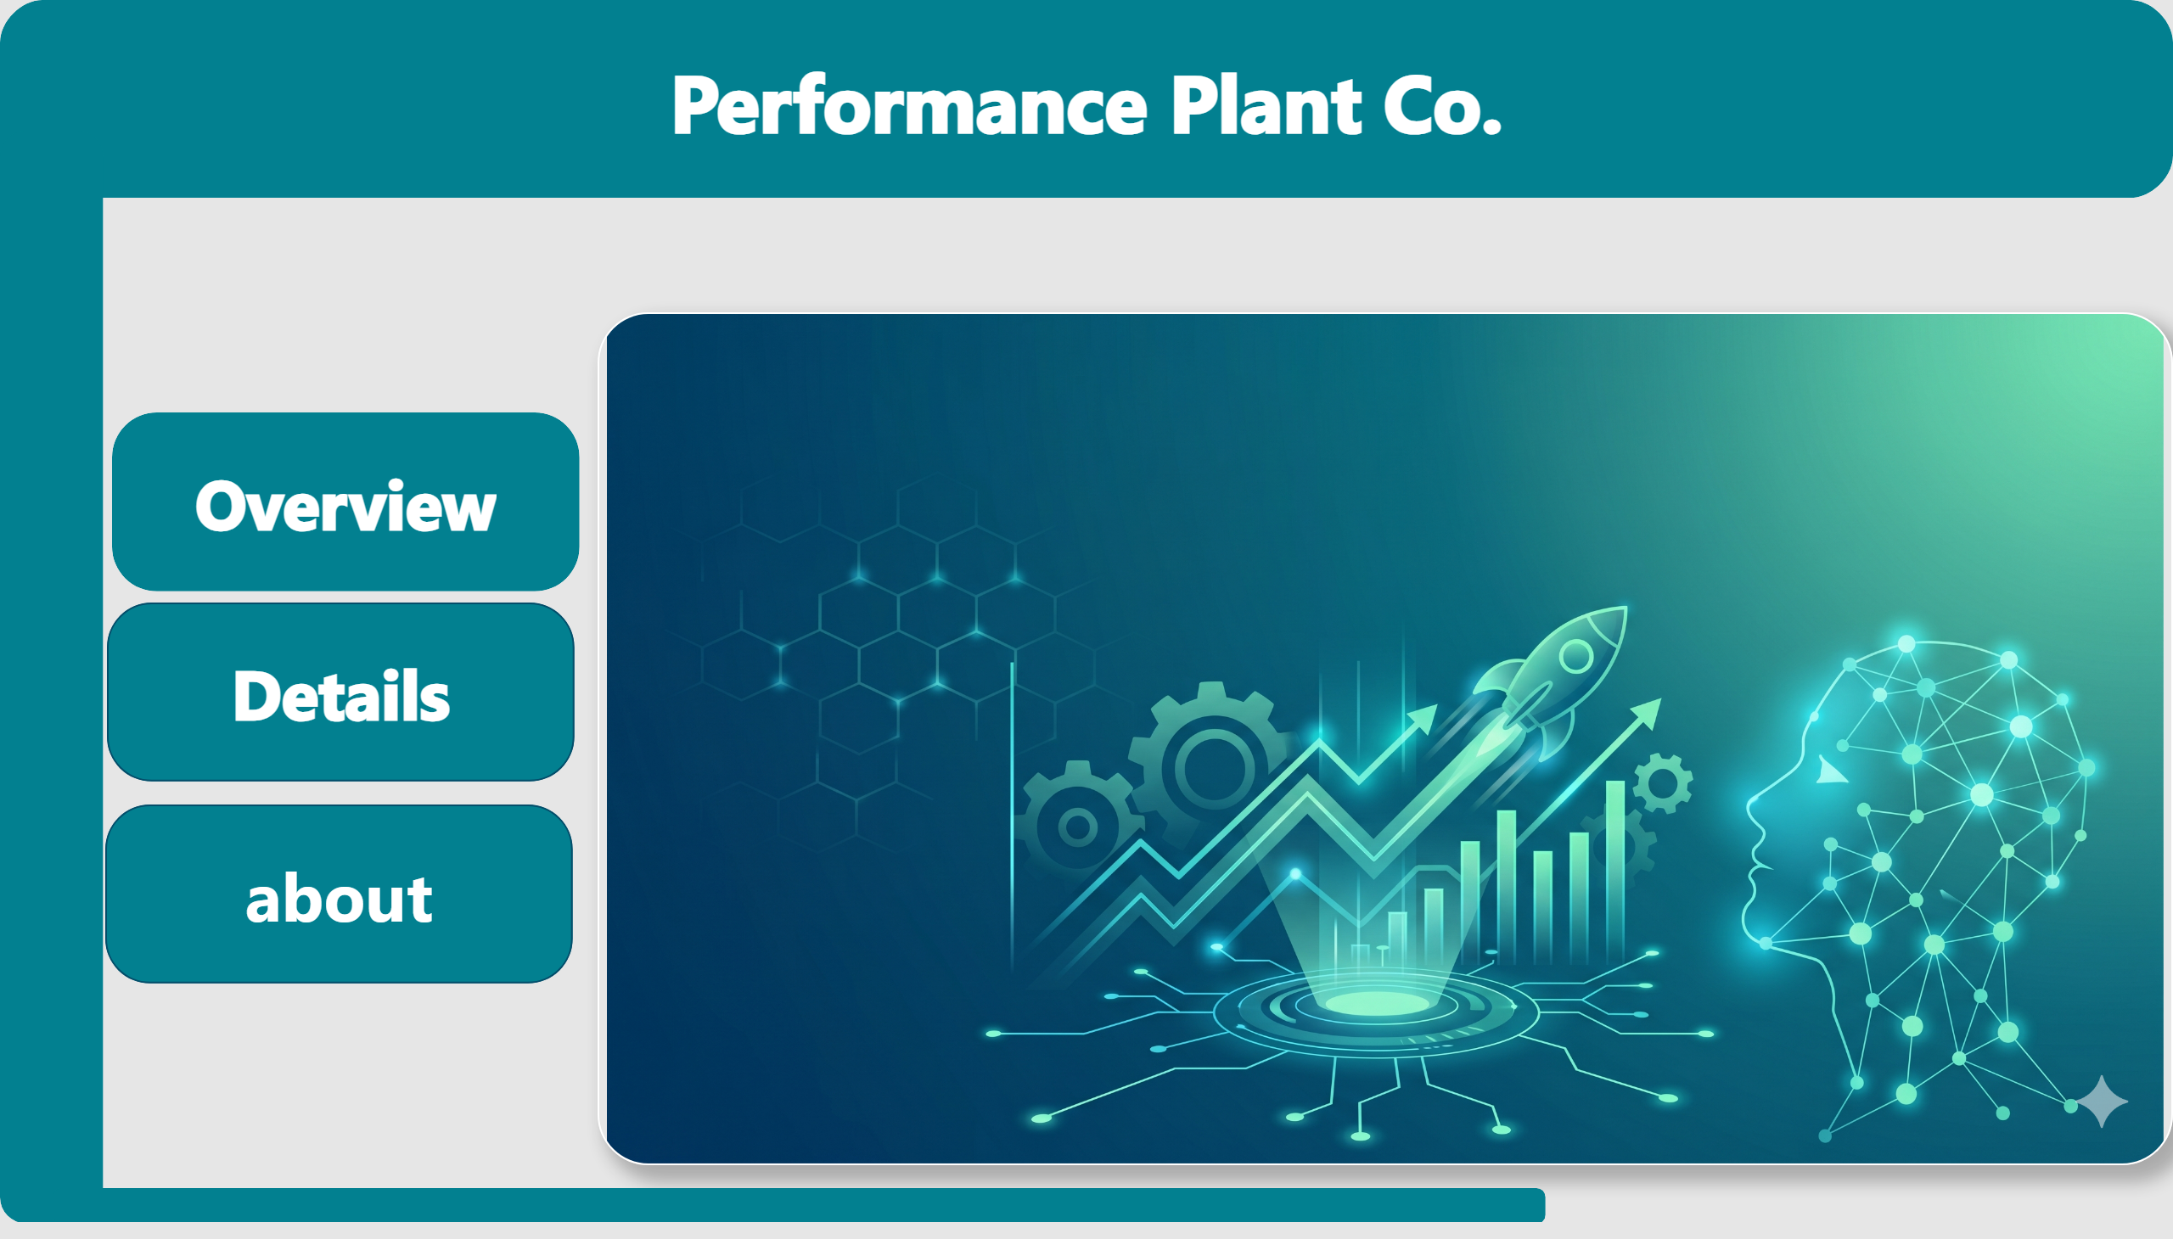
Home
Notes:
image
No alt text provided
shape
No alt text provided
shape
No alt text provided
shape
No alt text provided
shape
No alt text provided
shape
No alt text provided
shape
No alt text provided

Slide 2
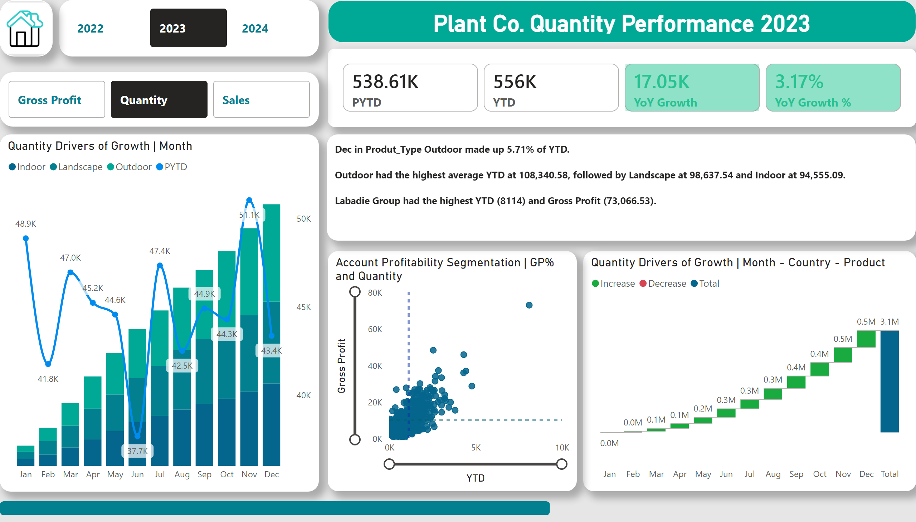
Overview
Notes:
cardVisual
No alt text provided
advancedSlicerVisual
No alt text provided
advancedSlicerVisual
No alt text provided
Quantity Drivers of Growth | Month - Country - Product
No alt text provided
Quantity Drivers of Growth | Month
No alt text provided
Account Profitability Segmentation | GP% and Quantity
No alt text provided
shape
No alt text provided
card
No alt text provided
textbox
No alt text provided
image
No alt text provided

Slide 3
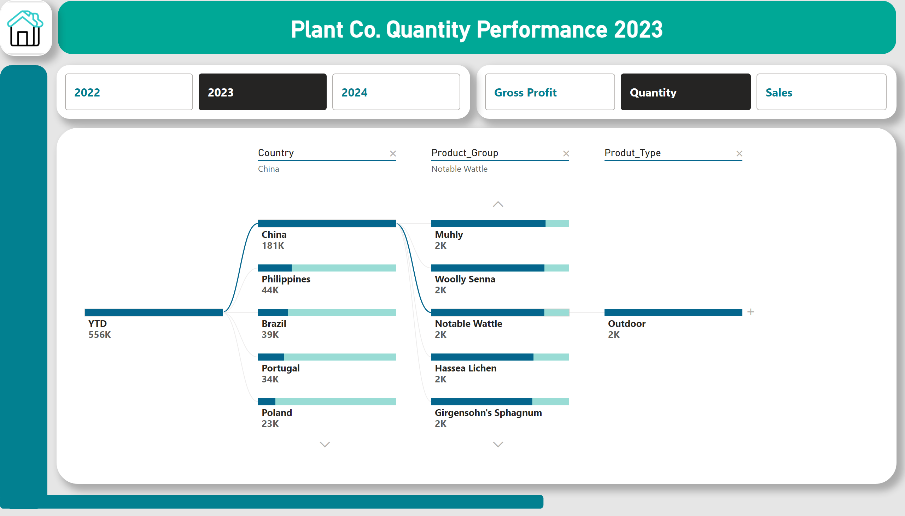
Details
Notes:
shape
No alt text provided
shape
No alt text provided
advancedSlicerVisual
No alt text provided
advancedSlicerVisual
No alt text provided
card
No alt text provided
decompositionTreeVisual
No alt text provided
image
No alt text provided

Slide 4
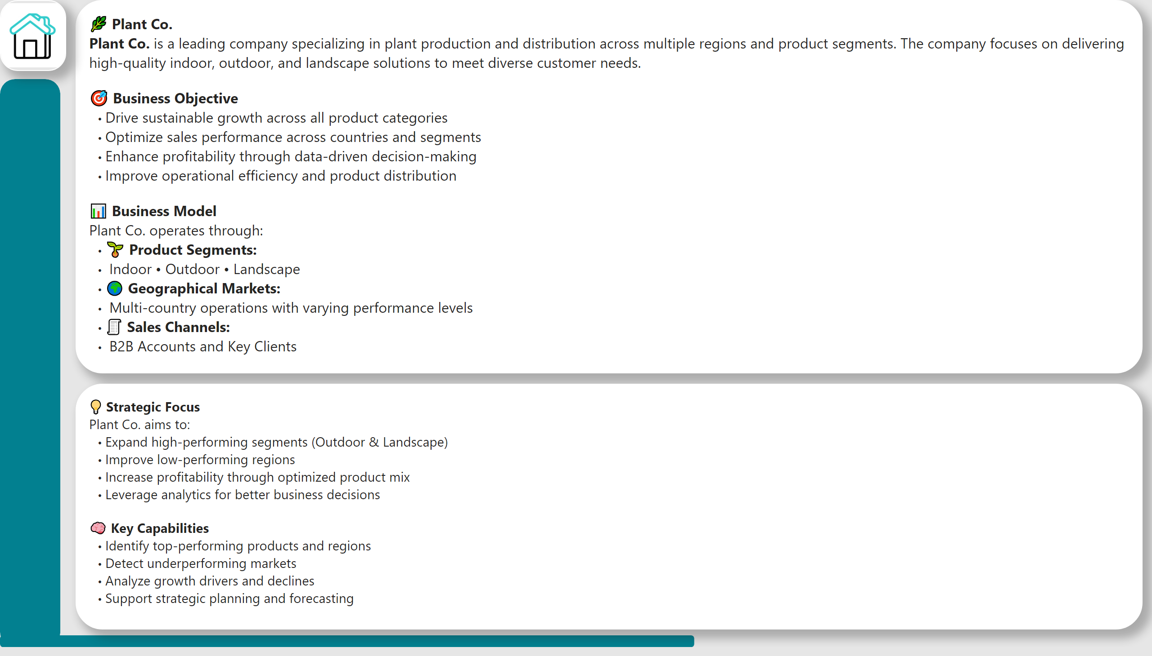
about
Notes:
shape
No alt text provided
shape
No alt text provided
textbox
No alt text provided
textbox
No alt text provided
image
No alt text provided

Slide 5



Plant Co. Performance Report
View in Power BI
Last data refresh:
4/27/2026 10:20:52 AM UTC
Downloaded at:
4/27/2026 10:42:04 AM UTC

